Slide 1

Developing Management Skills
Building Relationships by Communicating Supportively
4-<number>

Slide 2
Learning Objectives
Build supportive relationships even when delivering negative feedback
Avoid defensiveness and disconfirmation in interpersonal communication
Improve ability to apply principles of supportive communication
Improve relationships by using personal management interviews
4-<number>

Slide 3

Positive Relationships
Result in better physical and emotional well-being
Help people perform better at work and concentrate more on the task at hand.
4-<number>

Slide 4

Frequent Organizational Problems
Reliance on technology
Dominance of e-mail
Less face-to-face communication
4-<number>

Slide 5
Problems with Electronic Communication
Too much information, low quality
No content to information, lacks meaning
Interpretation of information depends on relationships with sender
4-<number>

Slide 6

Communication Problems
“Most individuals don’t seem to feel a strong need to improve their own skill level”
4-<number>

Slide 7

Focus on Accuracy
The ability to transmit clear and precise messages.
4-<number>

Slide 8
Inconsistent Pronunciations
‘We polish Polish Furniture.’
‘He could lead if he would get the lead out.’
‘A farm can produce produce.’
‘The dump was so full it had to refuse refuse.’
‘The present is a good time to present a present.’
‘The dove dove into the bushes.’
4-<number>

Slide 9
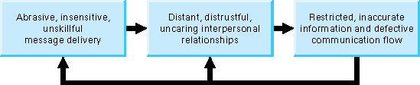
Relationships Between Unskillful Communication and Interpersonal Relationships
4-<number>

Slide 10
Coaching and Counseling
Coaching: giving advice, direction or information to improve performance.
Counseling: helping someone understand and resolve a problem him/herself by displaying understanding
4-<number>

Slide 11
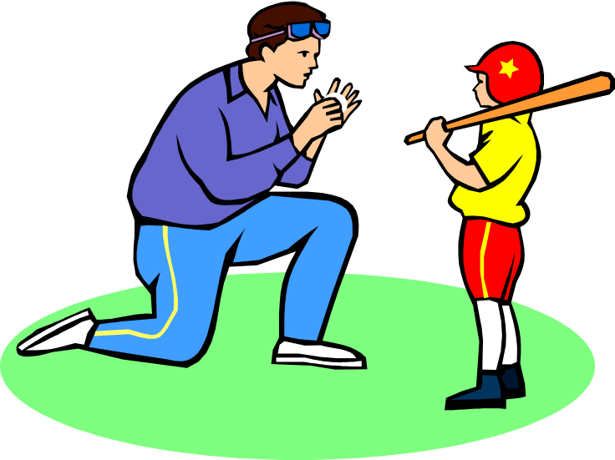

Coaching and Counseling
Coaching: focuses on abilities
Counseling: focuses on attitudes
4-<number>

Slide 12
When to Coach
Lack of ability
Insufficient information
Incompetence
Subordinate must understand the problem
4-<number>

Slide 13
When to Counsel
Personality clashes
Defensiveness
Other factors tied to emotions
“I can help you recognize that a problem exists.”
4-<number>

Slide 14
Obstacles to Supportive Communication
Defensiveness
  One individual feels threatened or attacked as a result of the communication
  Self-protection becomes paramount
  Energy is spent on constructing a defense rather than on listening
  Aggression, anger, competitiveness, and/or avoidance as a result of the communication
4-<number>

Slide 15
Obstacles to Supportive Communication
Disconfirmation
    Individual feels incompetent, unworthy, or insignificant as a result of the communication
    Attempts to reestablish self-worth take precedence
    Energy is spent trying to portray self-importance rather than on listening
    Showing off, self-centered behavior, withdrawal, and/or loss of motivation are common reactions
4-<number>

Slide 16

Supportive Communication
Helps the sender communicate accurately and honestly without jeopardizing interpersonal relationships.
4-<number>

Slide 17
Attributes of Supportive Communication
Congruent
Descriptive
Problem-Oriented
Validating
Specific
Conjunctive
Owned
Supportive Listening
4-<number>

Slide 18

Supportive Communication
Based on congruence: a match between what an individual is thinking and feeling
4-<number>

Slide 19
Supportive Communication
Is descriptive and reduces the tendency to evaluate and cause defensiveness.
4-<number>

Slide 20
Descriptive Communication
Describes objectively the event, behavior, or circumstance
Focus on the behavior and your reaction
Focus on solutions
4-<number>

Slide 21
Supportive Communication
Is problem-oriented and does not focus on personal traits which cannot be changed.
4-<number>

Slide 22
Supportive Communication
Validates and helps others feel recognized, understood, accepted, and valued.
4-<number>

Slide 23
Invalidating Communication
Conveys
Superiority
Rigidity
Indifference
Imperviousness
4-<number>

Slide 24
Validating Communication
Egalitarian
Flexible
Two-way
Based on agreement
4-<number>

Slide 25
Supportive Communication
Is specific and identifies something that can be understood and acted upon.
4-<number>

Slide 26
Global Communication
Focuses on extremes and absolutes which deny any alternatives. “My way or the highway!”
4-<number>

Slide 27

Supportive Communication
Is conjunctive and joined to a previous message.
4-<number>

Slide 28
Disjunctive Communication
Occurs when there is,
Lack of opportunity for others to speak
Extended pauses
Topic control
4-<number>

Slide 29
Interaction Management
Creates conjunction by:
Taking turns speaking
Management of timing
Topic Control
4-<number>

Slide 30
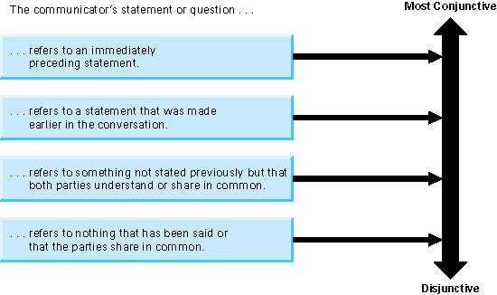
Continuum of Conjunctive Statements
Insert figure 4.2
4-<number>

Slide 31
Supportive Communication
Is owned and acknowledges the source of the idea. Ownership conveys responsibility.
4-<number>

Slide 32
Disowned Communication
Results in the listener never being sure of whose point of view the message represents.
4-<number>

Slide 33
Supportive Communication
Requires active listening and responding effectively to someone else’s statements.
4-<number>

Slide 34
Effective Listening
In skills important for managers, effective listening was ranked highest.
Individuals usually understand about a fourth of what is communicated.
4-<number>

Slide 35
Responding to Others
Four Types of Responses
  Advising
  Deflecting
  Probing
  Reflecting
4-<number>

Slide 36
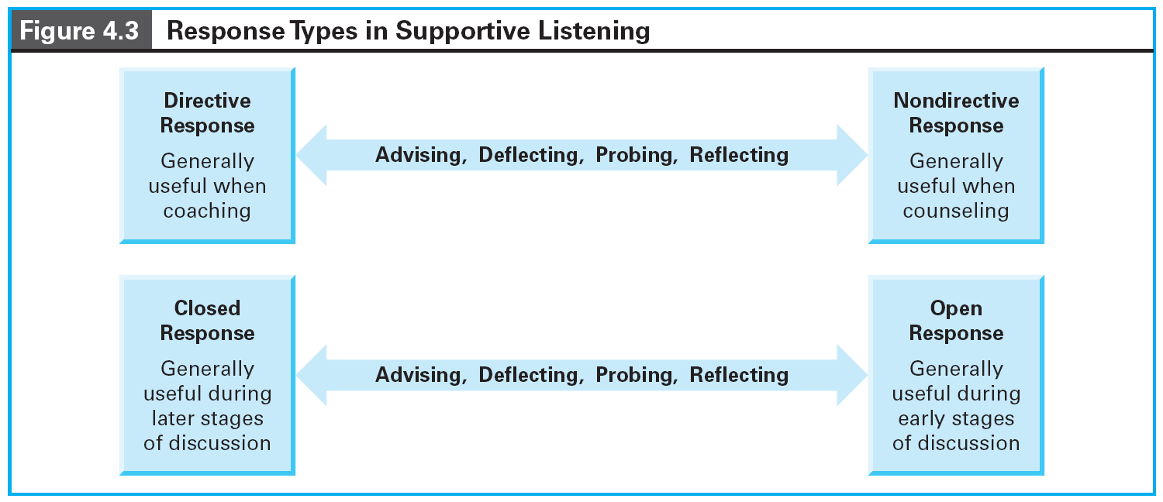
Response Types
4-<number>

Slide 37
Advising
Provides direction, evaluation, personal opinion, or instruction
Creates listener control over the topic
Can produce dependence
4-<number>

Slide 38
Deflecting
Switches the focus from communicator’s problem to on selected by the listener
Appropriate if reassurance is needed
Imply that the communicator’s issues are not important
4-<number>

Slide 39
Probing
Asks questions about what the communicator said
Used to gather information
Can appear that the communicator must justify what is happening
4-<number>

Slide 40

Four Types of Probes
Elaboration
Clarification
Repetition
Reflection
4-<number>

Slide 41
Reflecting
Mirror back to the communicator the message that was heard
Involves paraphrasing and clarifying
Could appear that the listener isn’t listening
4-<number>

Slide 42

Personal Management Interview
A regularly scheduled, one-on-one meeting between management and subordinates
4-<number>

Slide 43
Personal Management Interview
Step 1: A role-negotiation session which sets expectations’ of employees and managers.
Step 2: A set of on-going one on one meetings to development and improvement.
4-<number>

Slide 44
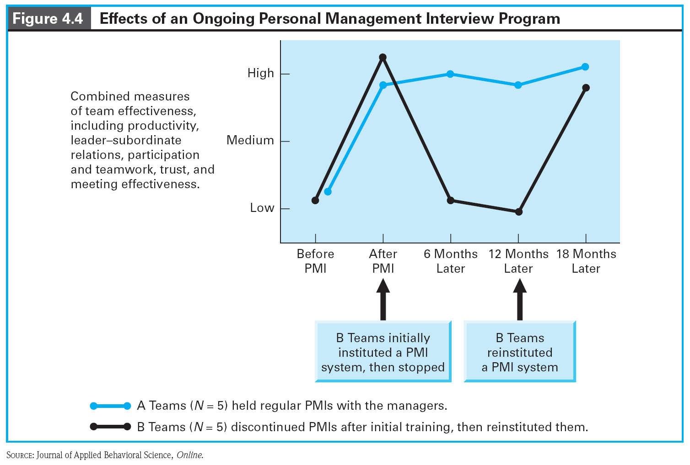
Effects of Personal Management Interview
4-<number>

Slide 45
Culture and Communication
Language pattern and structures are dramatically different across cultures
There are, however, universal principles that apply to interpersonal problems
4-<number>

Slide 46
Behavioral Guidelines
Differentiate between coaching situations and counseling situations
Use problem-oriented statements rather than person-oriented statements
Communicate congruently by acknowledging your true feelings without acting them out in destructive ways
4-<number>

Slide 47
Behavioral Guidelines
Use descriptive, not evaluative, statements
Use validating statements that acknowledge the other person’s importance and uniqueness
Use specific rather than global statements when correcting behavior
Use conjunctive statements that flow smoothly from what was said previously
4-<number>

Slide 48
Behavioral Guidelines
Own your statements, and encourage the other person to do likewise
Demonstrate supportive listening
Implement a personal management interview program characterized by supportive communication
4-<number>

